Slide 1


Slide 2

NETFLIX DATA ANALYSIS
This analysis focuses on exploring and understanding trends in Netflix's vast content library. We will examine how Netflix's collection has evolved over time, the variety of content it offers, and key patterns related to genres, countries, and content ratings.

Slide 3
Dataset Overview
Type
Title
Director & Cast
Rating
Duration
Genres
COUNTRY
Movies and TV Shows
The name of the show or movie
The key people involved
Where the content was produced
Release Year
The audience rating (e.g., TV-MA, PG-13)
The year of release
Length of the movie or number of seasons for TV shows
Categories like documentaries, dramas, comedies, etc.

Slide 4
Process Overview
Identifying Goals
01
Data Cleaning
02
03
Visualization

Slide 5
Analysis Goals
Movies vs.
TV Shows
Growth Over Time
Compare the proportion of Movies and TV Shows.
Which type is more prevalent on Netflix?
Analyze the growth of Netflix’s content library. How has the library expanded over the years?
Countries and Genres
Content Ratings and Durations
Identify dominant countries and genres. Which countries and genres are most represented?
Examine audience ratings and durations. What ratings are most common, and how do movie durations compare to TV show seasons?

Slide 6
Data Cleaning
Handling Null Values
Some colums contained missing values.
Imputed missing values with “Missing“ to ensure consistency.
Fixing Country Column Formatting
The Country column contained extra commas before or after country names.
Cleaned country names, e.g., replacing “Poland,” with “Poland” and “,South Korea” with “South Korea”.
Correcting Misplaced Duration Values
In specific records (IDs: S5542, S5795, S5814), Duration values were incorrectly placed in the rating column.
Moved those values to the correct Duration column and imputed missing Rating values with “Missing”.

Slide 7
Data
Visualization

Slide 8
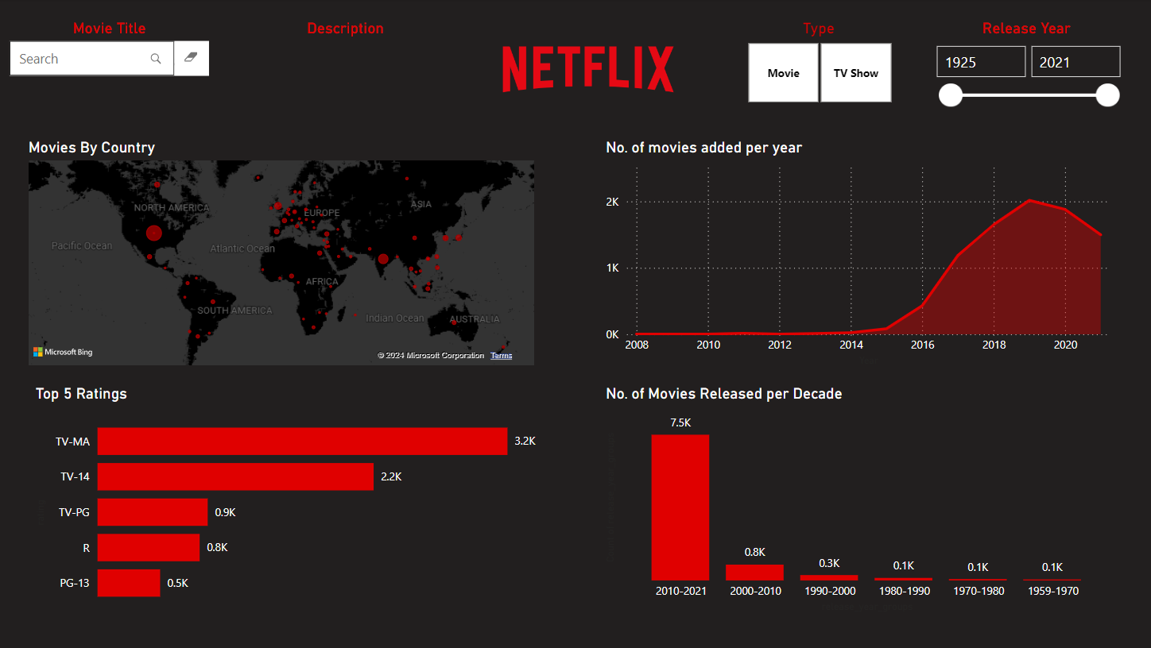

Slide 9
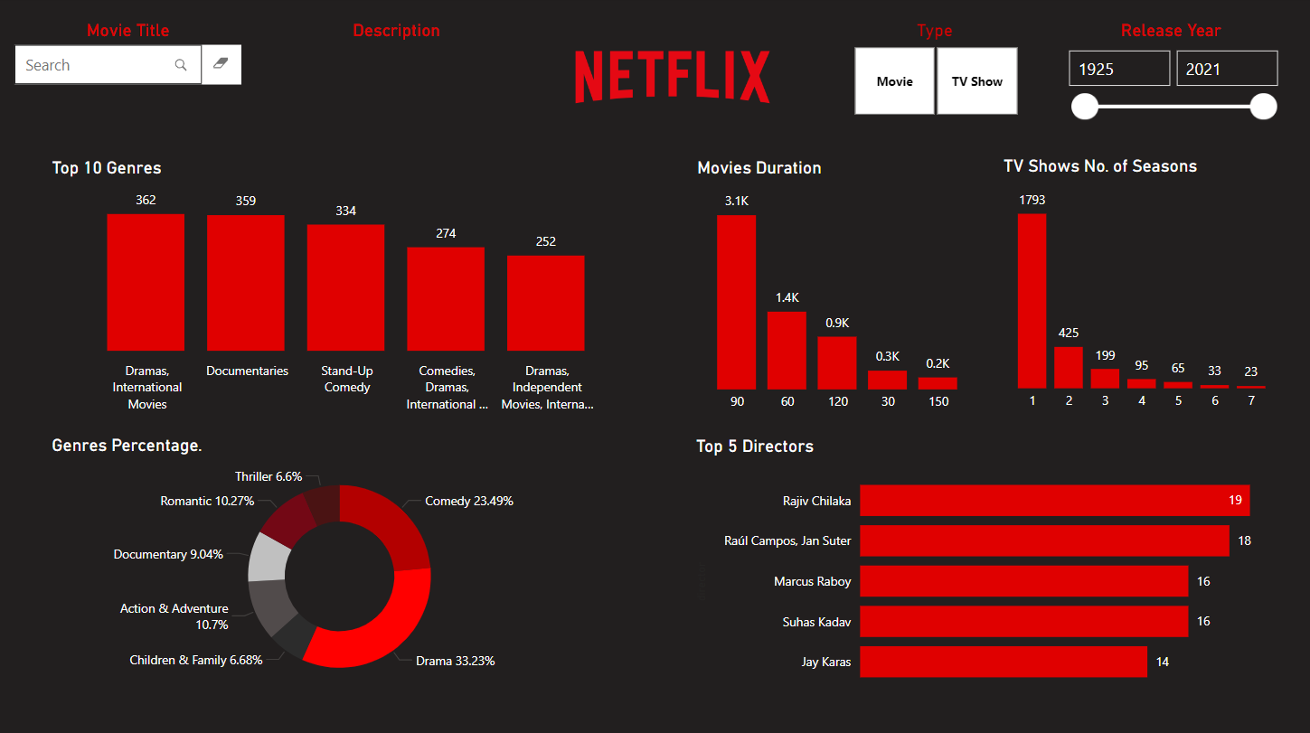

Slide 10
Header
Search Box
Enables users to search for specific movies or TV shows by title.
Release Year Range
Allows users to filter content based on the year of release, helping to analyze trends within a certain time frame.
Description
Description of the Movie/TV Show
Content Type Filter Allows users to filter content based on whether it's a movie or TV show, enabling a more specific analysis.

Slide 11
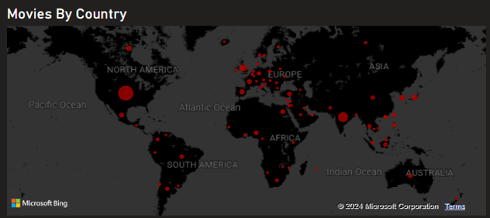
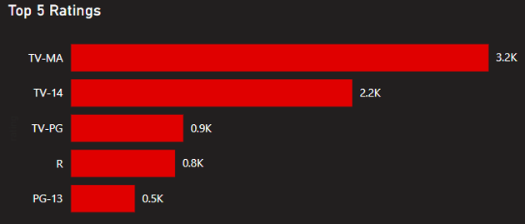
Movies By Country
Top 5 Ratings
Description: Visualizes the geographic distribution of Netflix’s content.
Insight: Highlights which countries contribute the most to Netflix’s library, with larger circles representing more content from a specific region.
Description: Displays the most common audience ratings on Netflix.
Insight: Helps understand the target audience by showing which ratings are most prevalent, with TV-MA being dominant.

Slide 12
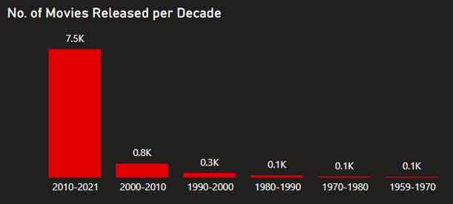
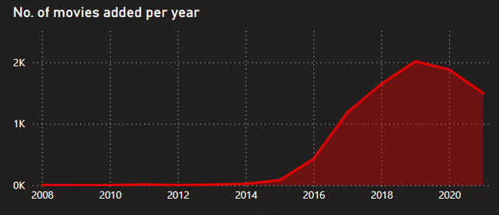
Number of Movies Released per Decade
Number of Movies Added per Year
Description: Breaks down Netflix’s content releases by decade.
Insight: Highlights how Netflix’s catalog is predominantly filled with recent releases from 2010-2020, reinforcing its rapid growth in this period.
Description: Tracks the number of movies added to Netflix's platform annually.
Insight: Shows the rapid expansion of Netflix’s movie library, with a noticeable spike post-2015.

Slide 13
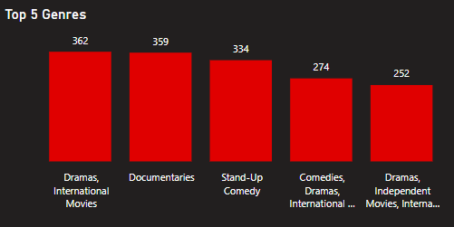
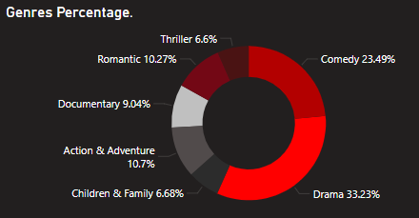
Top 5 Genres
Genres Percentage
Description: Shows the most popular genres on Netflix, ranked by the number of titles.
Insight: Dramas and Documentaries dominate, showing that these are key content types Netflix focuses on.
Description: Displays the genre distribution as a percentage.
Insight: Breaks down Netflix's catalog by major genre groups, showing that Drama and Comedy together make up over half of Netflix's content, while other genres such as Documentaries and Action & Adventure play smaller roles.

Slide 14
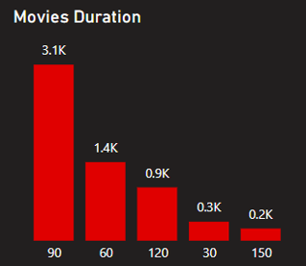
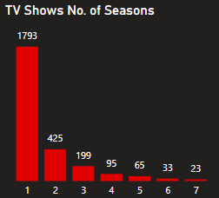
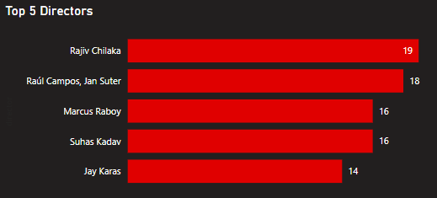
Movies & TV Shows Duration
Top 5 Directors
Description: Shows the distribution of movie durations and the number of seasons for TV shows on Netflix.
Insight:
Description: Displays the directors with the most Netflix titles.
Insight: Rajiv Chilaka leads with the most directed content, showcasing prolific creators on the platform.
For Movies, the majority have a runtime of around 90 minutes.
For TV Shows, most have only one season, indicating that Netflix has a large number of limited series or recently released shows.

Slide 15
Recommendations
Expand Content from Underrepresented Countries
Short terms
Produce More Multi-Season TV Shows
Diversify Movie Durations
Increase Family-Friendly Content

Slide 16
Thanks
Do you have any questions?

